Slide 1

Schedule dynamic social meetings, without spamming your friends
Tom Shadmi, 032585853
Yuval Ran, 032513483
Netanel Kaufman, 036497980

Slide 2
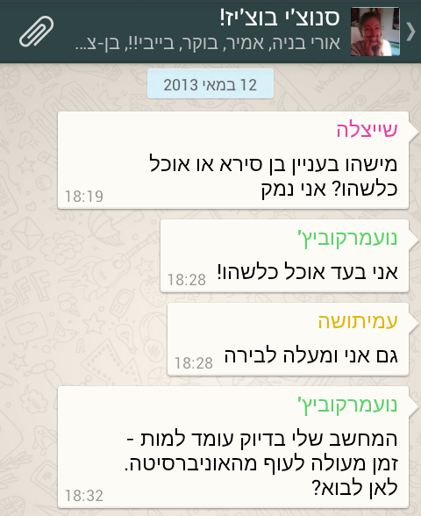
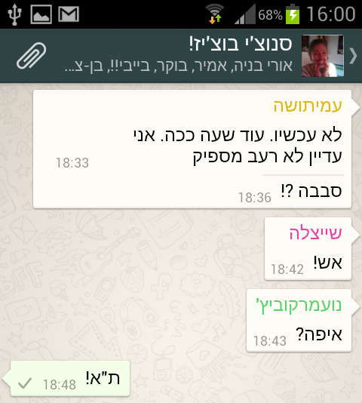
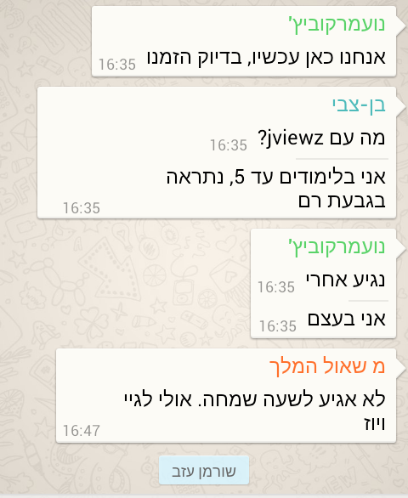
~ Motivation

Slide 3
Description
Create and manage (short-terms) events
Have the full picture (who, where, when...)
Chat with the invitees
Don’t get spammed

Slide 4
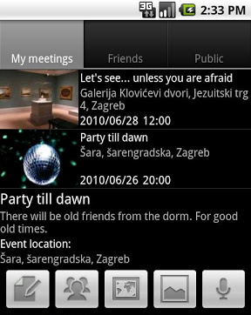
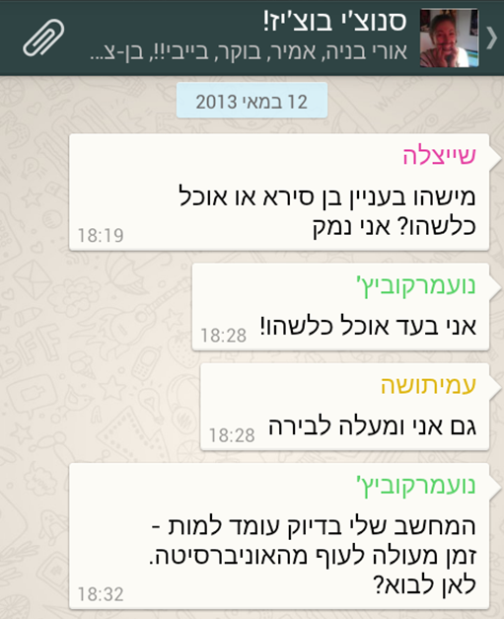
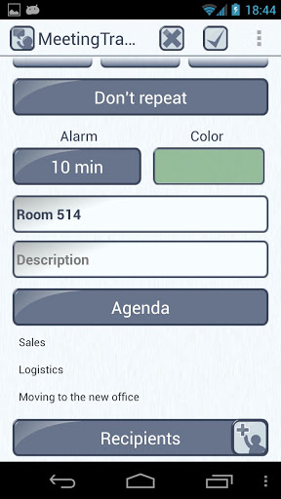
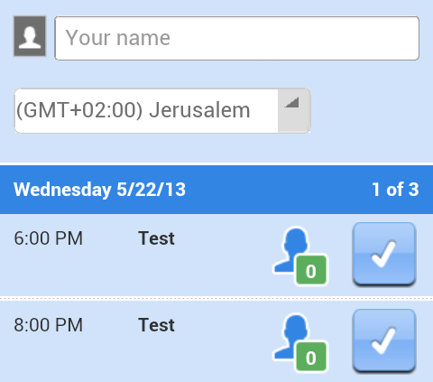
So far...
Meet Friends
No Groups
No events
Bad interface
Chaotic
Unstoppable
Meeting Tracker
No chat
WhatsApp
Doodle

Slide 5
App4Beer - comparative advantage
Use groups
Update the event
Don’t get bugged after declining
Chat with the invitees
Know the status

Slide 6
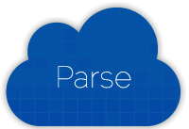
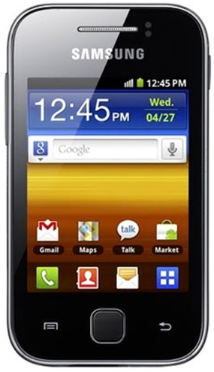

Architecture
Event data
Push notification
Confirmation data
Confirmation notification
Attend
Create event
Application preferences
Enter application

Slide 7
Demo

Slide 8
Cheers
Feedback / Questions?

